Slide 1


Regressors Final Project
Presenting: Nathan and Yaniv

Slide 2
BACKGROUND
The task it to build a ML model, based on regressors, which can predict the salary, using the traits which were given.
The data is not trivial to train upon and needs some cleaning, analyzing, and formatting to be of meaning to the model.
We are given a dataset with people, their traits, and their salaries.

Slide 3
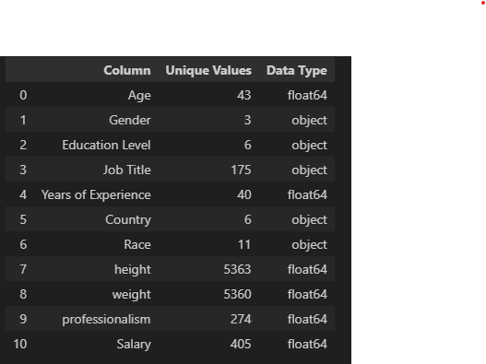
Some variables have low number of unique values which makes them encodable.
VARIABLES OVERVIEW
There are 6 categorical features and 5 numerical.

Slide 4
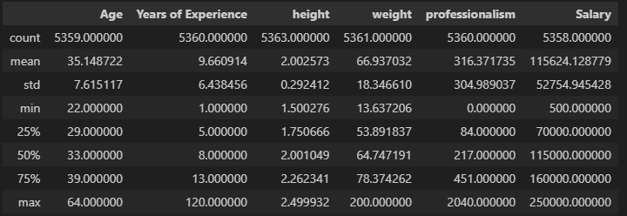
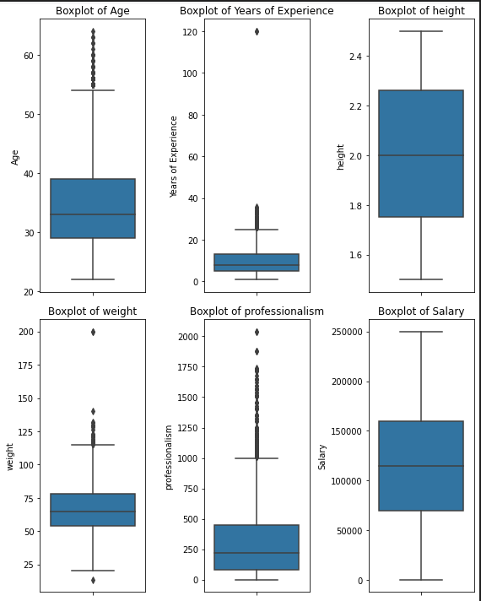
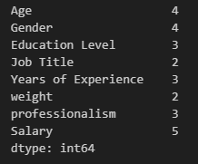
FEATURE ENGINEERING
Distribution of numerical features
Exploration
Missing Values

Slide 5

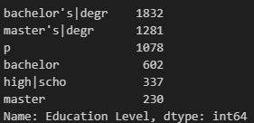
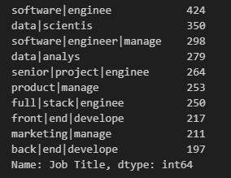
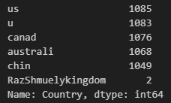
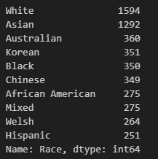
FEATURE ENGINEERING
Categorical Features
Gender
Education
Job Title
Country
Race
Conclusions
There are not enough data for other gender.
Education, Job Title and Countries are malformed.
Race is no balanced.

Slide 6
FEATURE ENGINEERING
Solutions
Job Title
Used a vector of correct job titles to find the most similar job title to the incorrect ones using Levenshtein distance.
Used Onehot encoding on predefined job categories which were extracted.
Used ordinal encoding on the seniority of the job (with predefined keywords).
Gender
Removed the “Other” gender.
Country
Used a dictionary of correct values to fix it
Onehot encoding.
Education
Used a dictionary of correct values to fix it
Ordinal encoding.
Race
Onehot encoding.
Numerical features
removal of outliers.
scaled using Standard Scaler.

Slide 7
MODELS AND EVALUATION
There were two major questins in mind after we have prepared the data:
What features to use to train the model ?
What model to use for the final prediction ?
The solution
Create three datasets to train the models on and check where the models perform better:
Option A - All the fixed/filtered fields.
Option B - Only the features that made sense to influence the salary, i.e. no race, weight, height.
Option C - remove just the height as it didn't have any correlation with any of the features.

Slide 8
And test all the models !
Lasso
Ridge
KNN
DecisionTree
LinearRegression

Slide 9

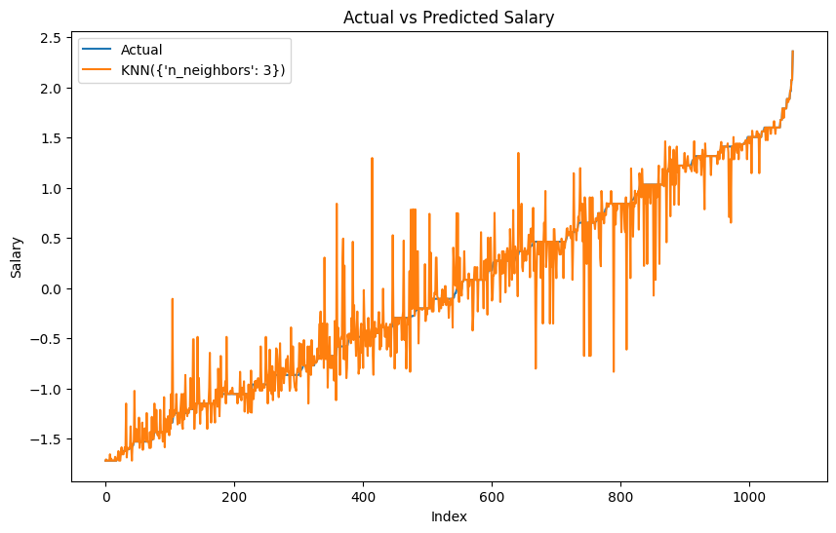
Winning Model: KNN
Winning Dataset: Option B
Model: KNN, params: {'n_neighbors': 3}, MSE: 0.0613

Slide 10
Insights
Not always more is better; less features, but relevant will improve the model.
If not sure just try it all.
Understanding and exploring the data before the training is crucial for creating a performant model.

